Slide 1
Science Journal Progect
Kuznetsov Alexander
GitHub: https://github.com/AlexanderKuznetsov13/sciencejournal

Slide 2
Used technologies
Java 11
Apache Maven (project build)
Spring Boot 2 (for MVC and dependency injection)
Spring AOP (use aspects for logging)
PostgreSQL 13 (data storage)
Liquibase (database migration & deployment)
Postman (for testing of REST endpoints)

Slide 3
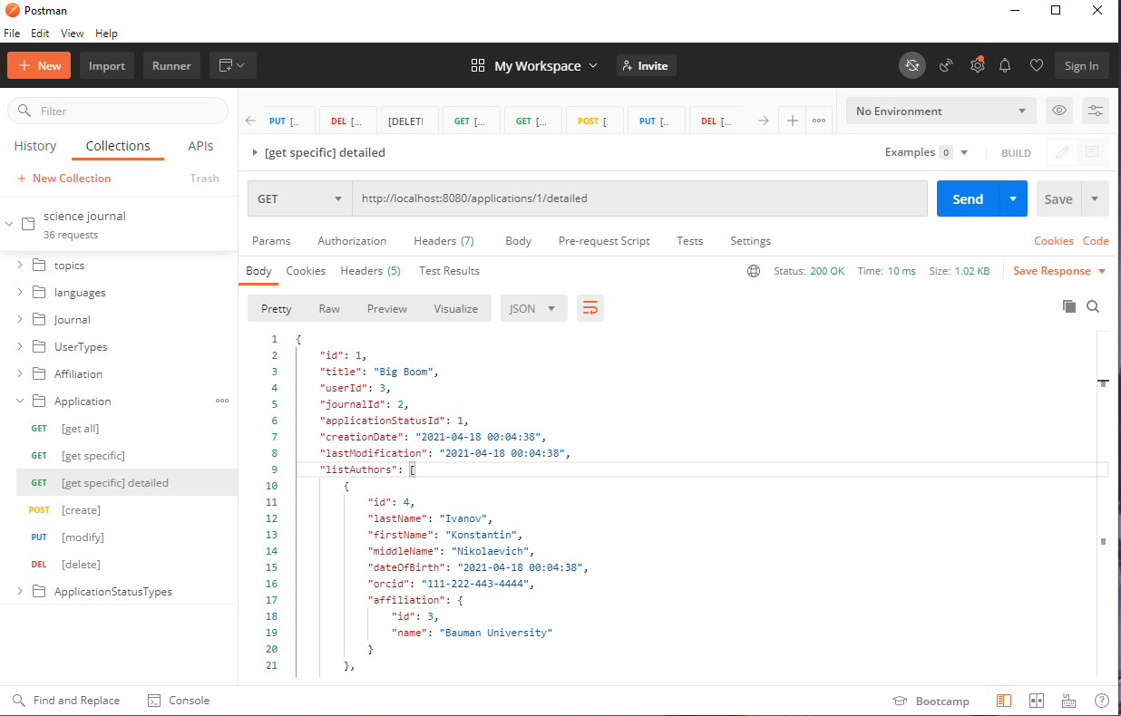
Postman (for testing of REST endpoints)

Slide 4
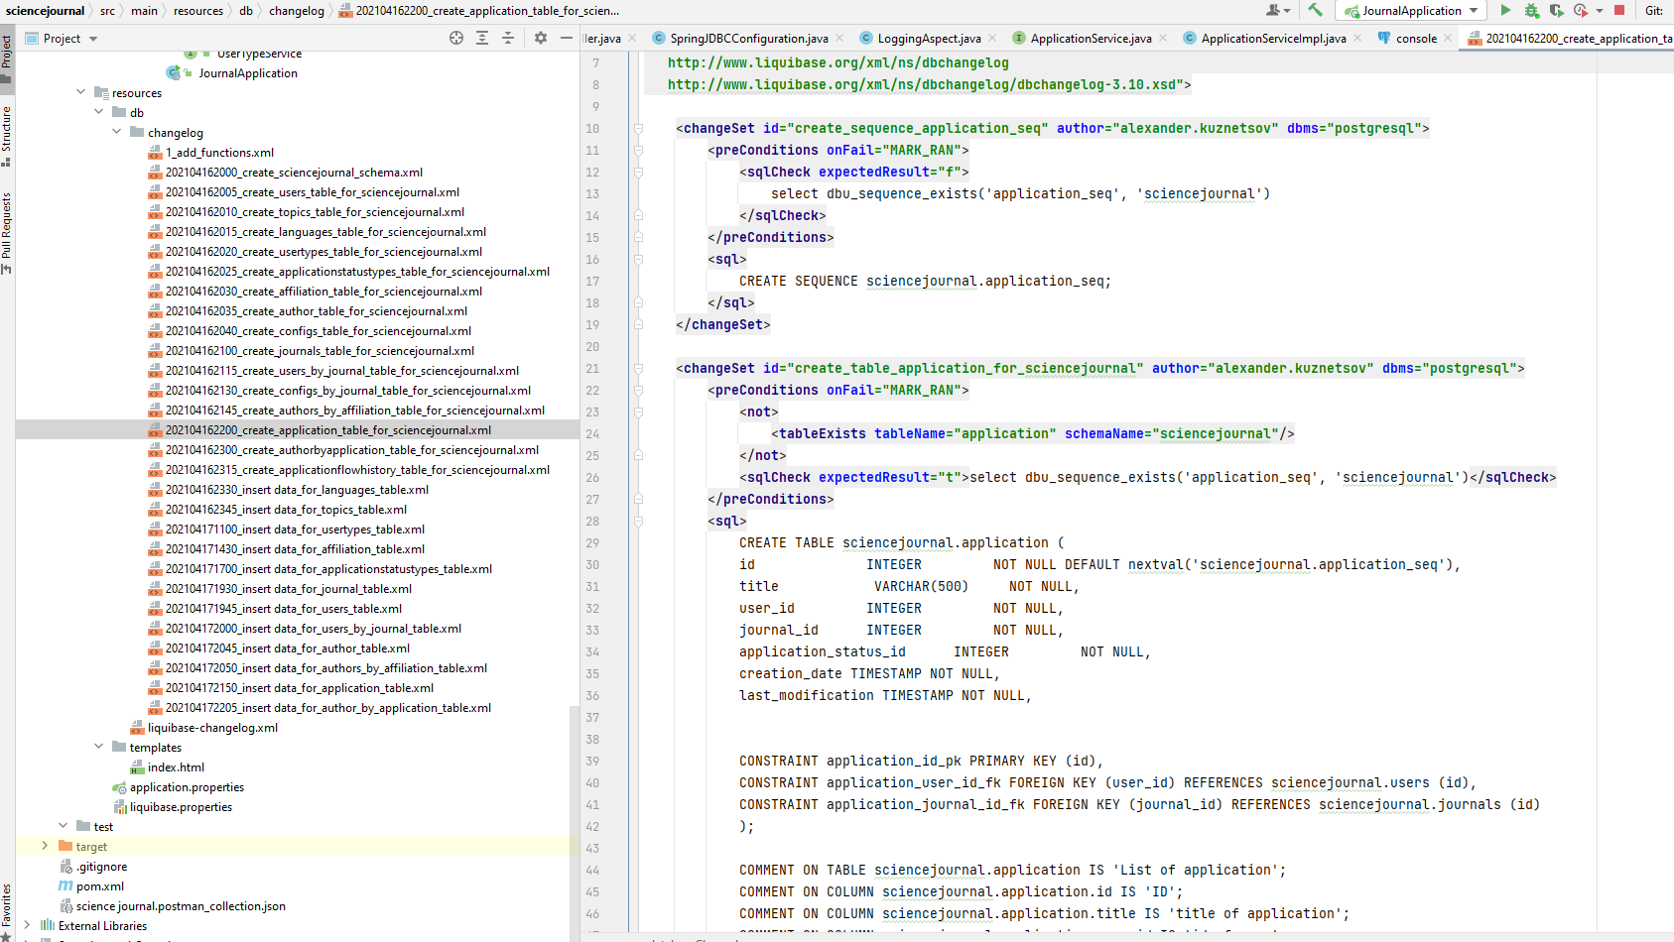
Liquibase

Slide 5
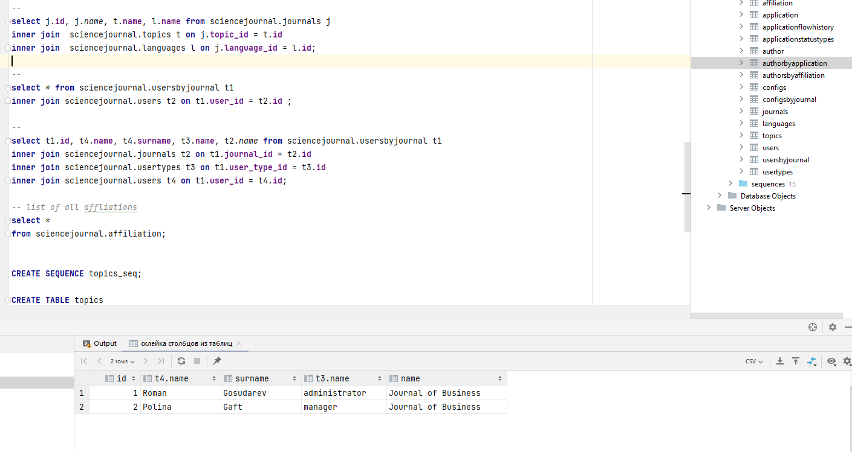
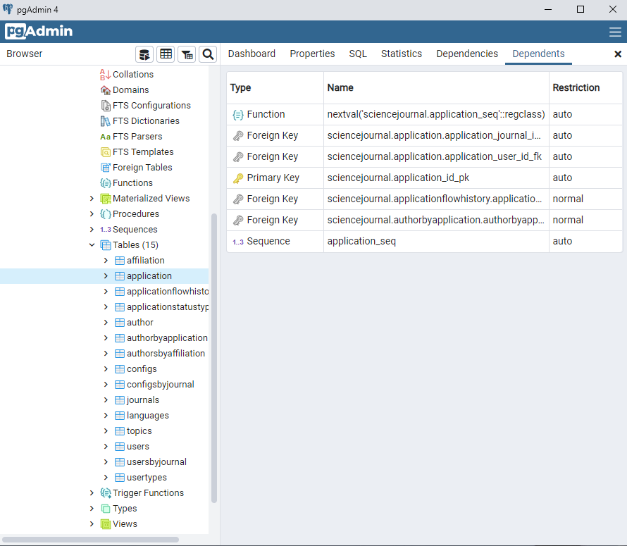
PostgreSQL 13/pgAdmin

Slide 6
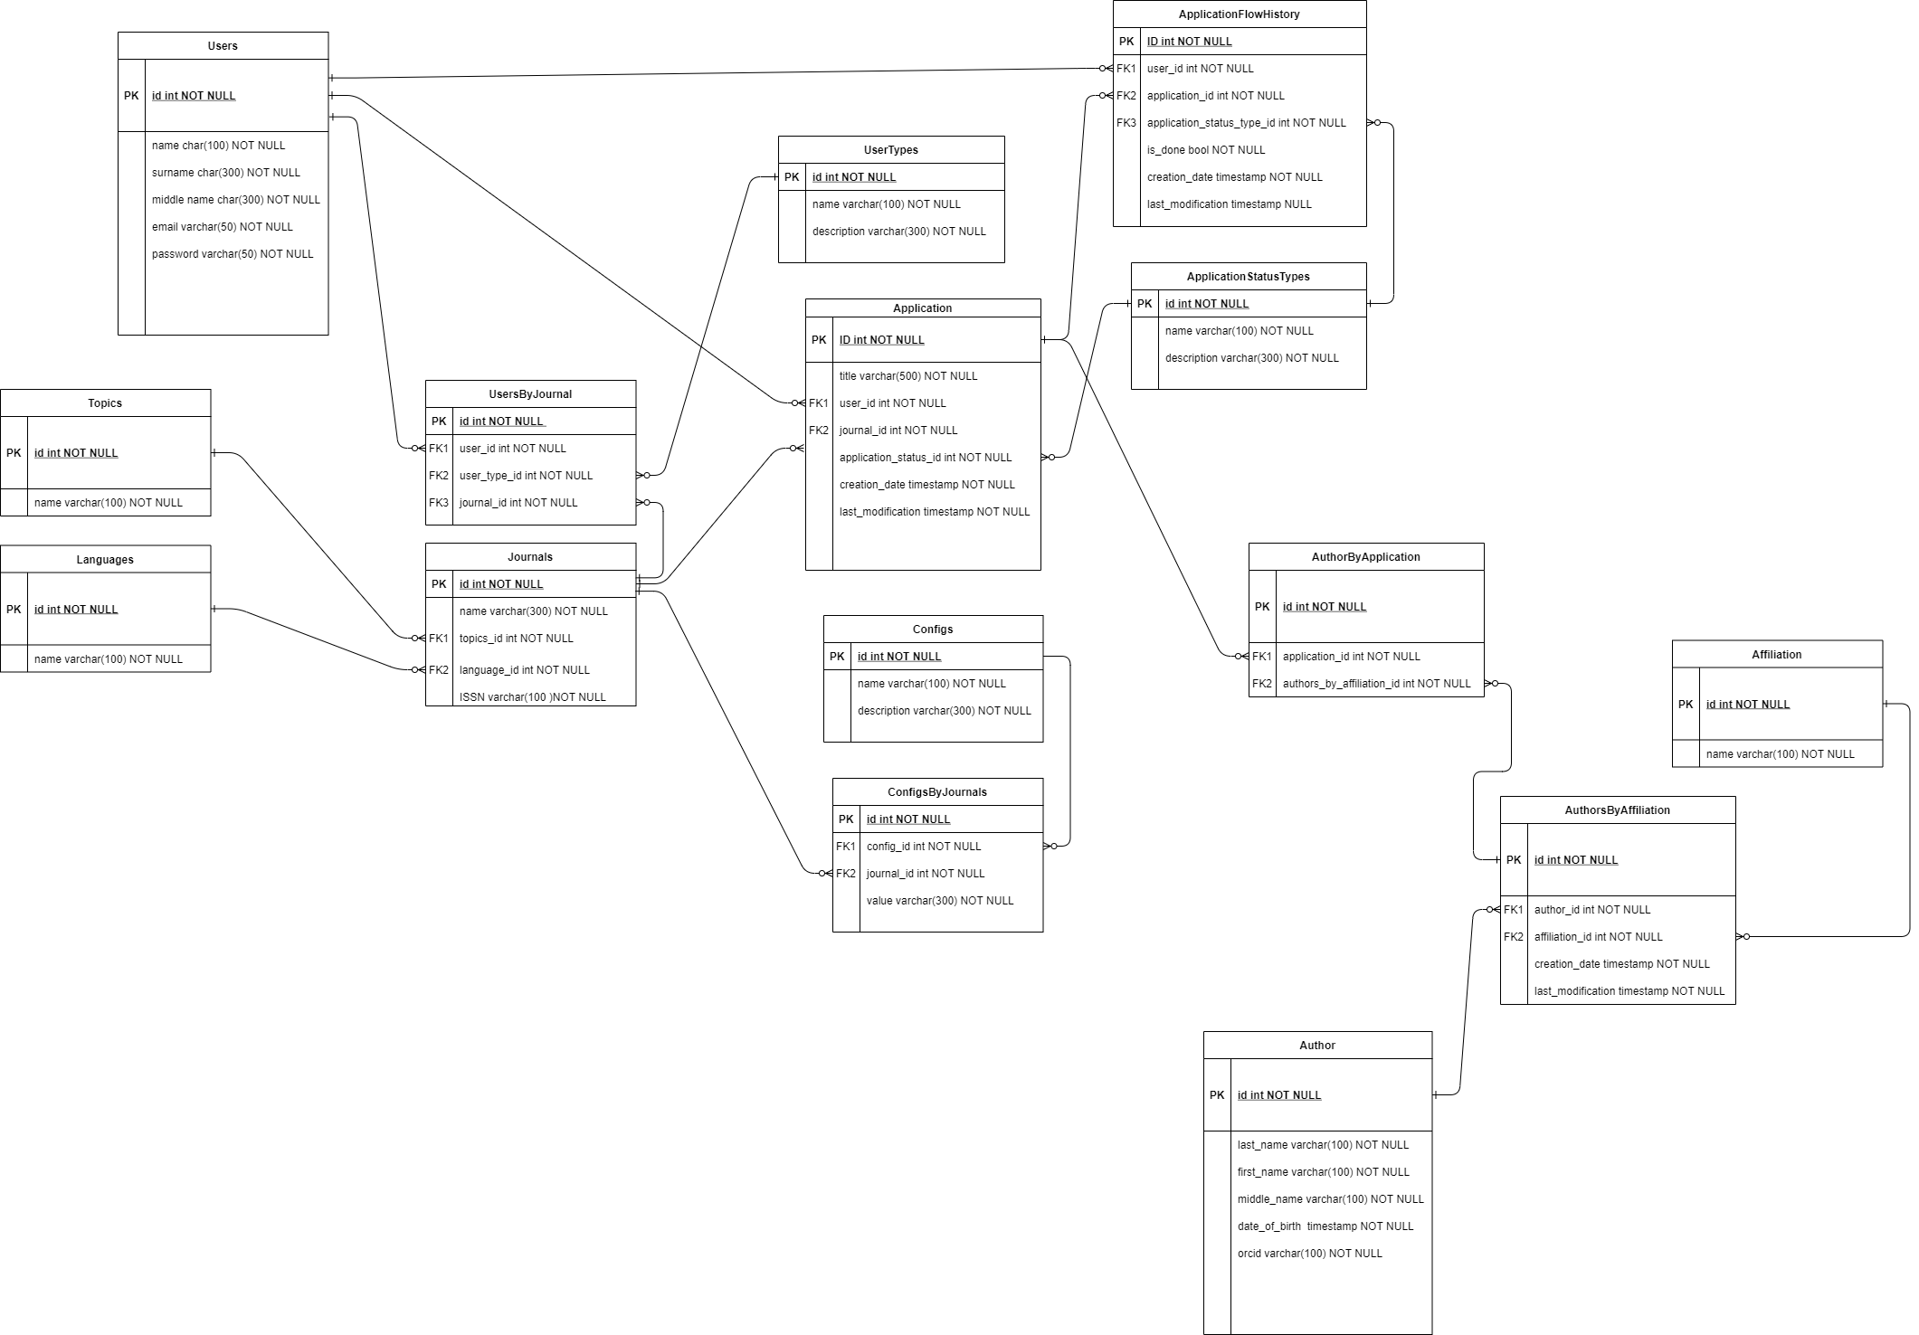
Database diagram (draw.io)

Slide 7
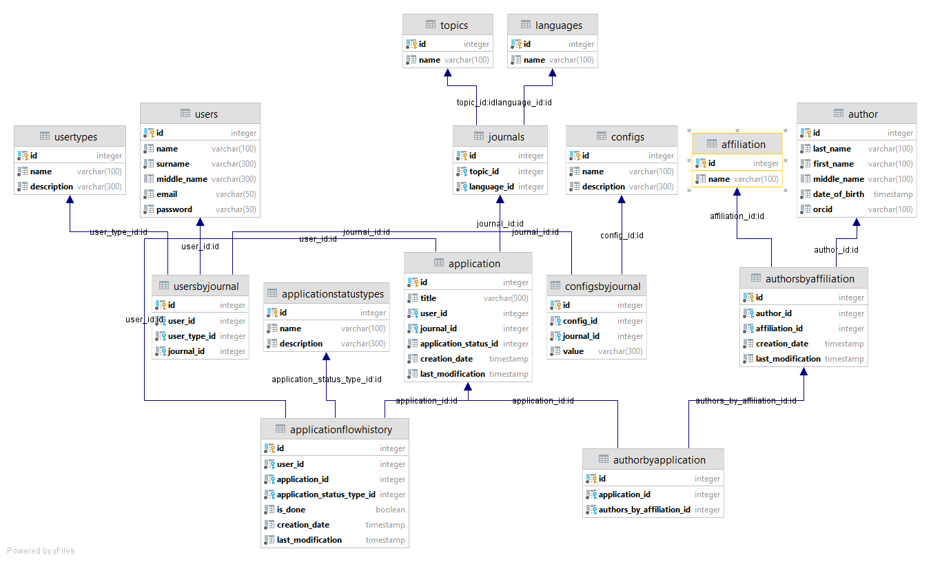
Database diagram (Exported from Intellij IDEA)

Slide 8
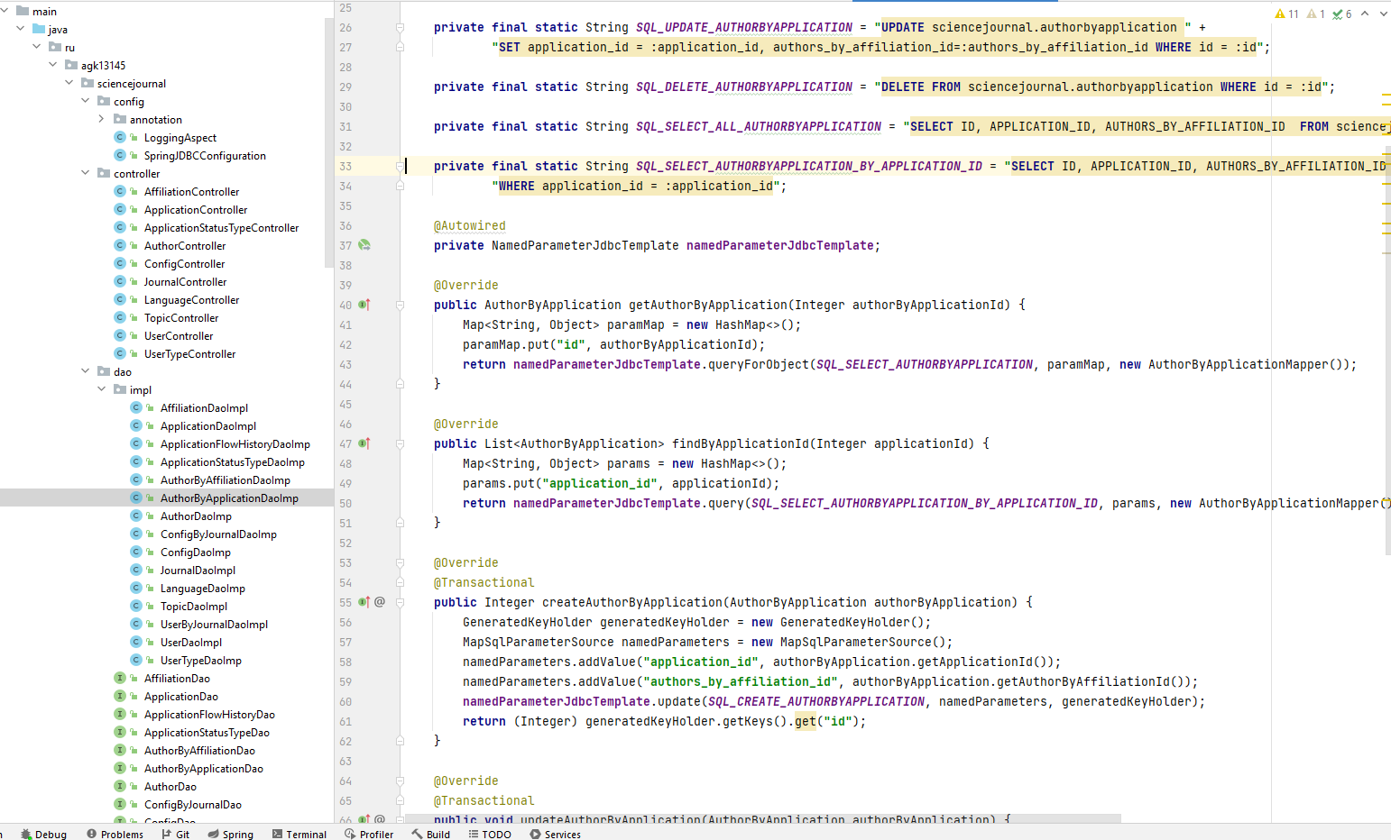
DAO for database tables

Slide 9
Live presentation

Slide 10
FUTURE
create Review microservice + Notification microservice
Add queue (RabbitMQ, Apache Kafka)
Add Docker support (container runtime)
Add tests

Slide 11
The End
Thanks for listening

